Slide 1
Data Visualization & Interpretation
Febin.A.Vahab

Slide 2
RECAP

Slide 3
Data Viz-Definition
Visualisation as a discovery tool(Anscombe’s Quartet)
Visualisation Objectives

Slide 4
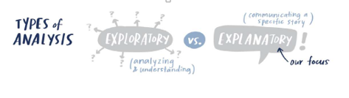
Car Manufacturer
DressMart Inc.
Article from NewYork Times
EDA on IRIS Data

Slide 5
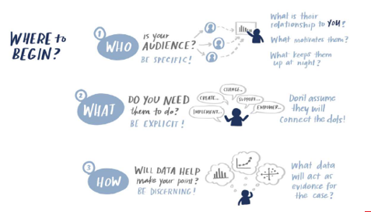
Visualisation Context
CASE Study
Summer Learning Programme
Clothing Retailer
DSE Electives
CANVAS
Higher Education
People Analyst

Slide 6
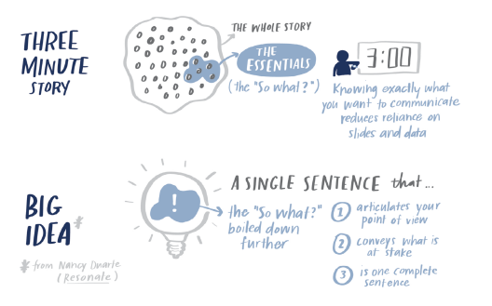

Slide 7
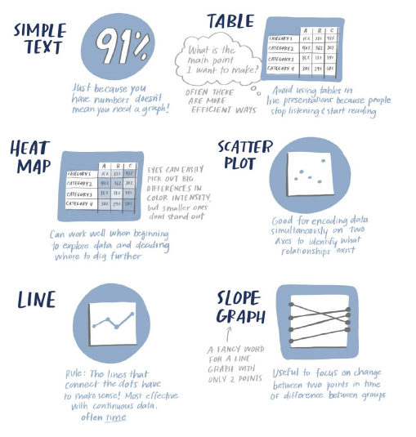
Types of Visuals

Slide 8
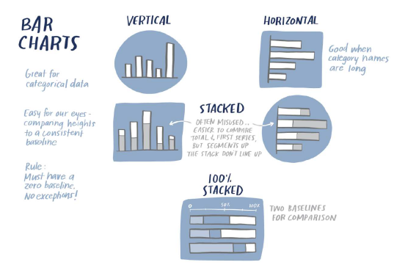
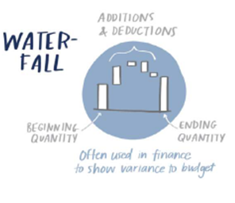
Types of Visuals
CASE Study
Summer Learning Programme
New Client Tier Share
Graphs to be avoided

Slide 9
SESSION 4 -PLAN
Gestalt Principles of Visual Perception
Decluttering
Pre-attentive Attributes

Slide 10
Gestalt Principles of Visual Perception
Principles
Proximity
Similarity
Enclosure
Closure
Continuity
Connection.
Focal point
Figure and ground

Slide 11
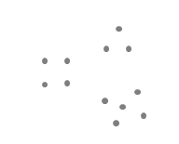

Gestalt Principles of Visual Perception
Gestalt Law of Proximity

Slide 12
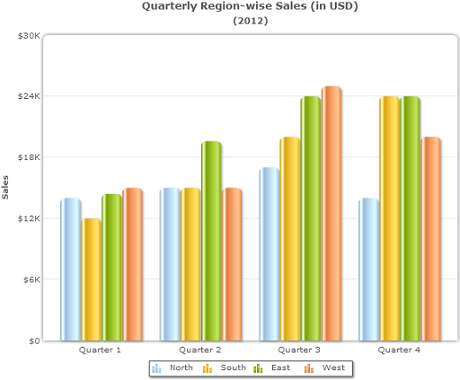
Gestalt Principles of Visual Perception
Gestalt Law of Proximity (example)

Slide 13
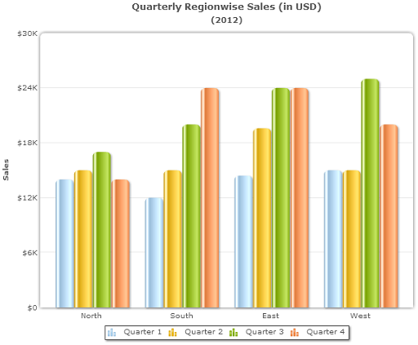
Gestalt Principles of Visual Perception

Slide 14
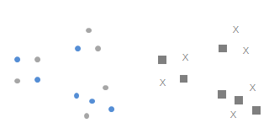
Gestalt Principles of Visual Perception
Gestalt Law of Similarity

Slide 15
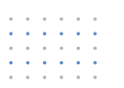
Gestalt Principles of Visual Perception
Gestalt Law of Similarity

Slide 16
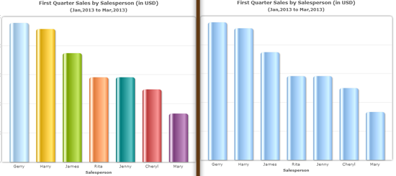
Gestalt Principles of Visual Perception
Gestalt Law of Similarity (example)

Slide 17
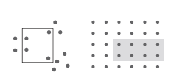
Gestalt Principles of Visual Perception
Gestalt Law of Enclosure

Slide 18
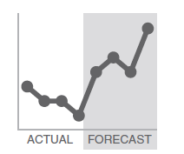
Gestalt Principles of Visual Perception

Slide 19

Gestalt Principles of Visual Perception
Gestalt Law of Closure

Slide 20
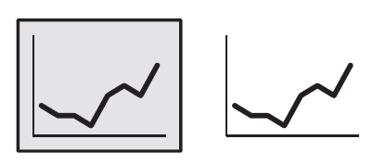
Gestalt Principles of Visual Perception
Gestalt Law of Closure

Slide 21
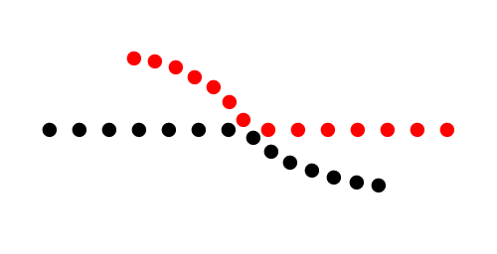
Gestalt Principles of Visual Perception
Gestalt Law of Continuity

Slide 22

Gestalt Principles of Visual Perception
Gestalt Law of Continuity

Slide 23
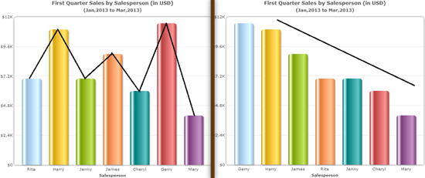
Gestalt Principles of Visual Perception
Gestalt Law of Continuity (example)

Slide 24

Gestalt Principles of Visual Perception
Gestalt Law of Connection

Slide 25
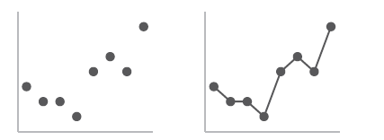
Gestalt Principles of Visual Perception
Gestalt Law of Connection

Slide 26

Gestalt Principles of Visual Perception
Gestalt Law of Focal Point

Slide 27
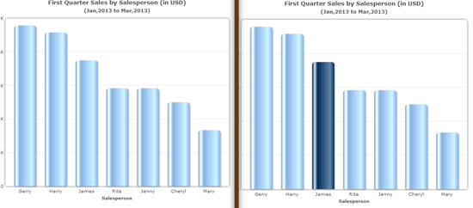
Gestalt Principles of Visual Perception
Gestalt Law of Focal Point (example)

Slide 28
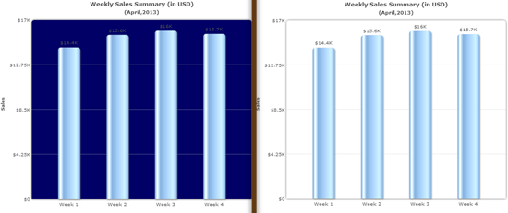
Gestalt Principles of Visual Perception
Gestalt Law of Figure/Ground

Slide 29

WHAT DO YOU SEE?

Slide 30

Figure-ground

Slide 31
Figure AND Ground
Blurriness
Size
Separation

Slide 32
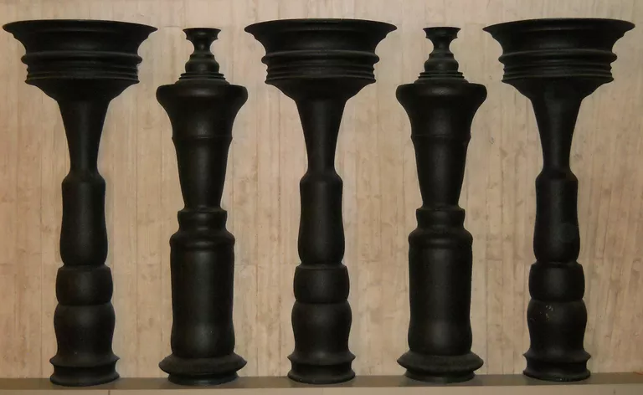
Figure-ground

Slide 33
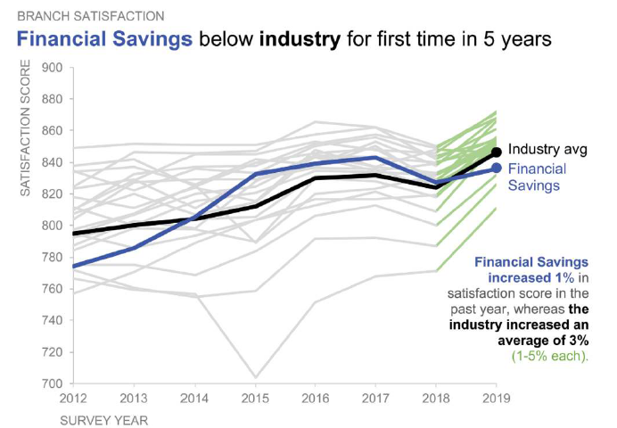
Question-Identify the gestalt principle in use.

Slide 34

Question-Identify the gestalt principle in use.

Slide 35
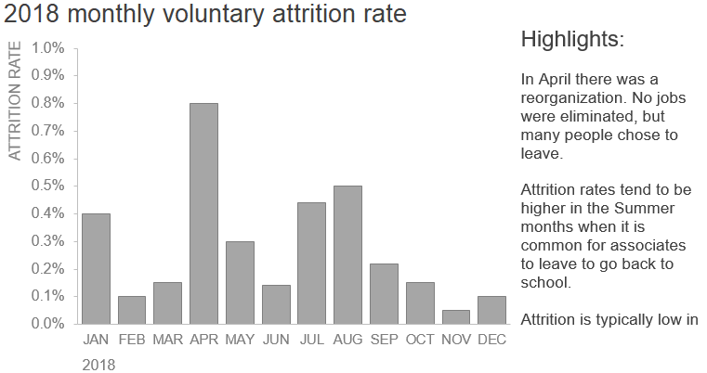
Question-Identify how to use gestalt principles.

Slide 36
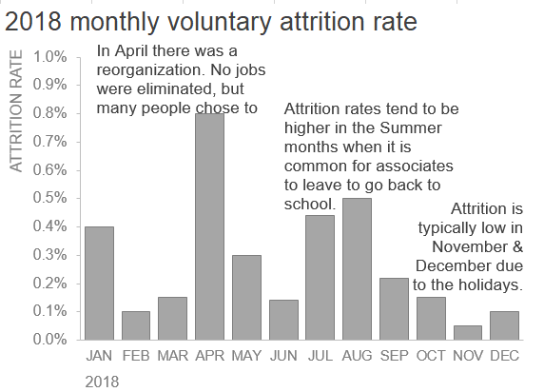
Question-Identify how to use gestalt principles-Proximity

Slide 37
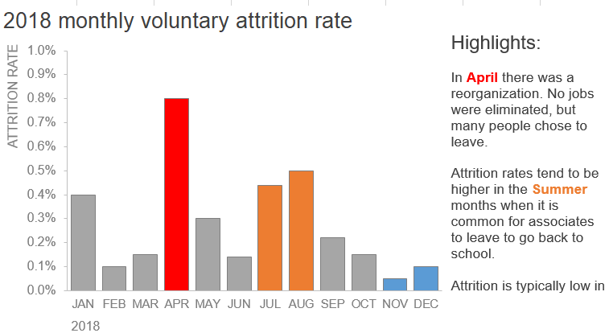
Question-Identify how to use gestalt principles-Similarity

Slide 38
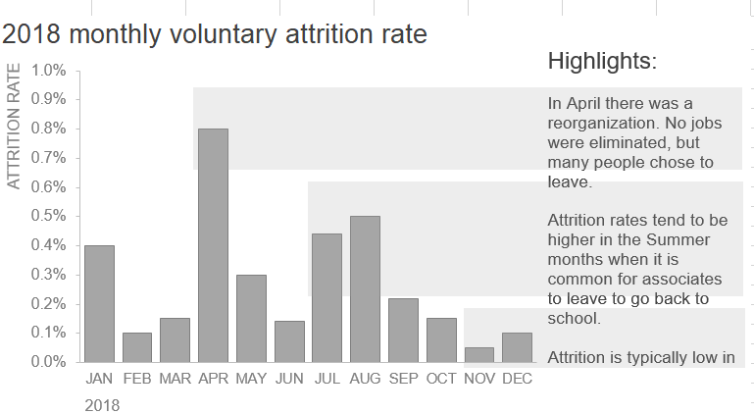
Question-Identify how to use gestalt principles-Enclosure

Slide 39
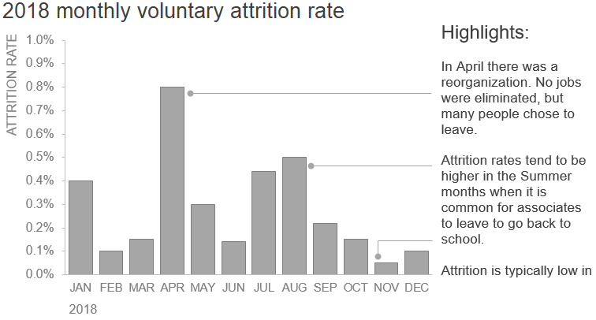
Question-Identify how to use gestalt principles-Connection

Slide 40
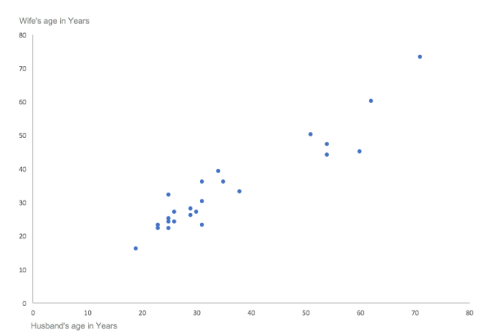
Question-Identify the gestalt principle in use.

Slide 41
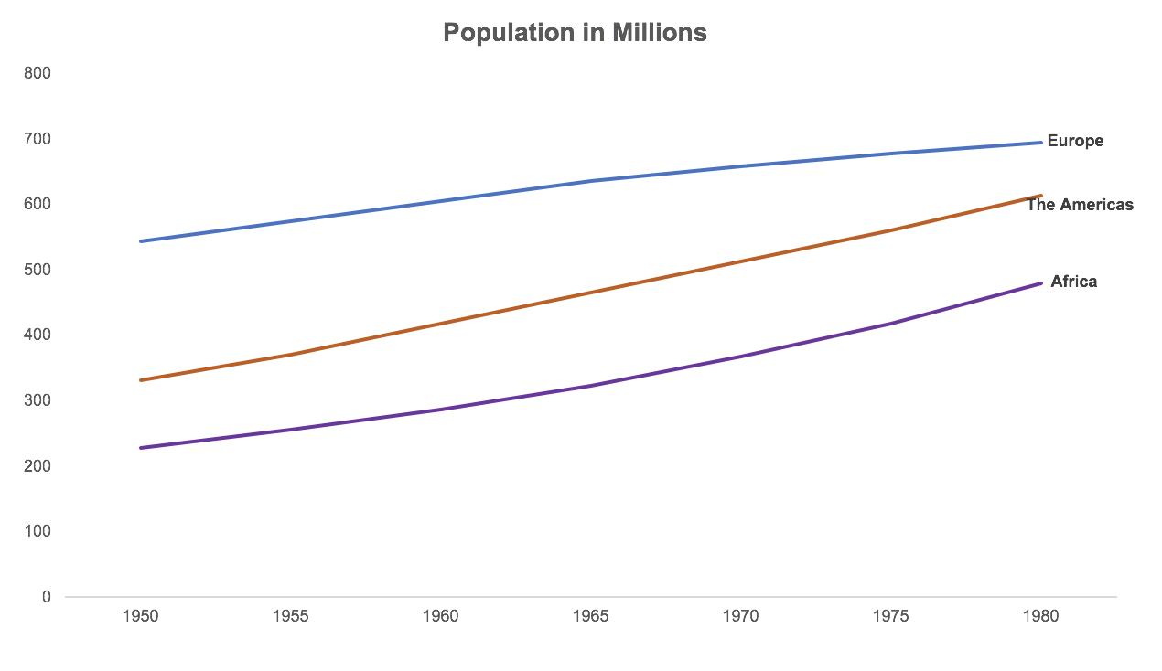
Question-Identify the gestalt principle in use.

Slide 42
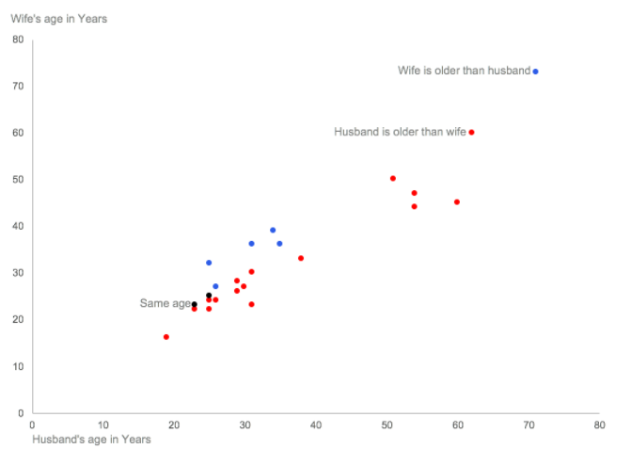
Question-Identify the gestalt principle in use.

Slide 43
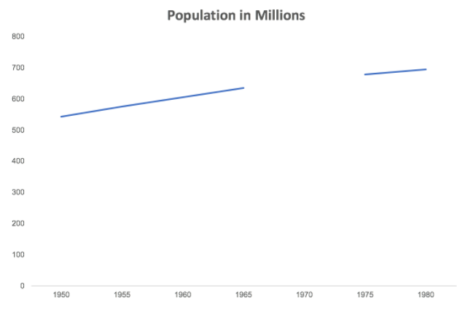
Question-Identify the gestalt principle in use.

Slide 44
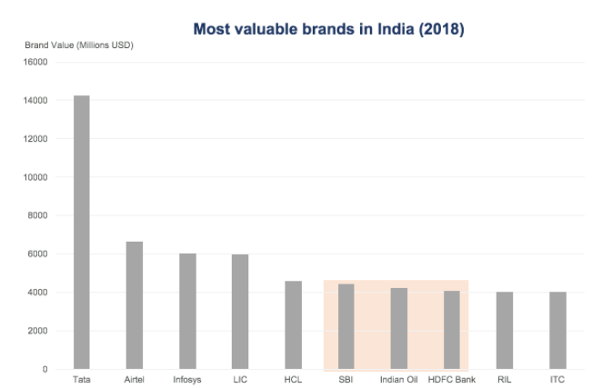
Question-Identify the gestalt principle in use.

Slide 45
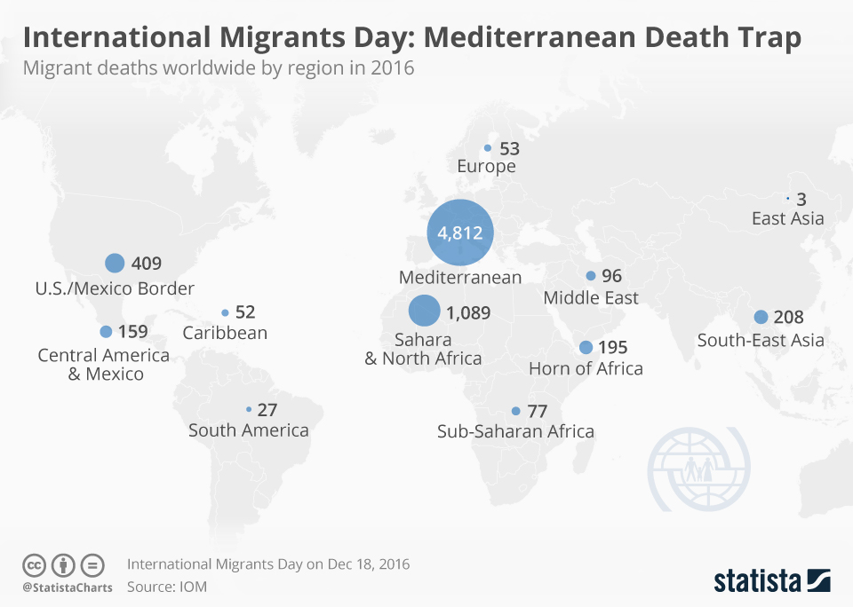
Question-Identify the gestalt principle in use.

Slide 46
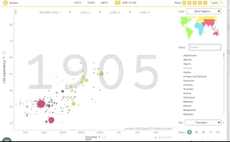
Question-Identify the gestalt principle in use.
https://www.ted.com/talks/hans_rosling_the_best_stats_you_ve_ever_seen

Slide 47
Thank You!

